Slide 1



Royal College of Music Museum
IN MY HEART

Slide 2

My heart is full of feelings

Slide 3
Big feelings and...
...small feelings

Slide 4


Loud feelings and quiet feelings

Slide 5

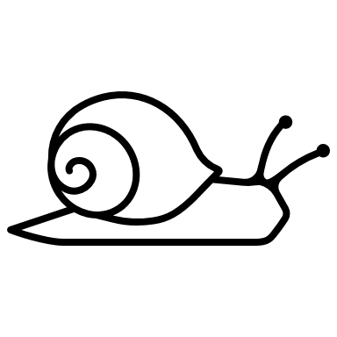
Quick feelings...
...and slow feelings​

Slide 6







My heart is like a house with all these feelings living inside.

Slide 7
Sometimes my heart feels like a big yellow star, shiny and bright.

Slide 8

I smile from ear to ear and twirl around so fast.
I feel as if I could take off into the sky!

Slide 9

This is when my heart is happy.

Slide 10

Some days my heart feels as heavy as an elephant.

Slide 11

There’s a dark cloud over my head and tears fall like rain.

Slide 12

This is when my heart is sad.

Slide 13
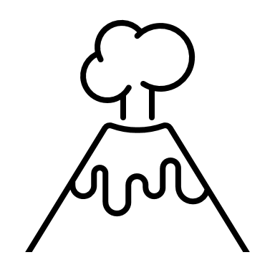
When I get really angry, my heart feels as if it’s going to explode!
Don’t come near me!

Slide 14



My heart is yelling, hot and loud.
This is when my heart is mad.

Slide 15
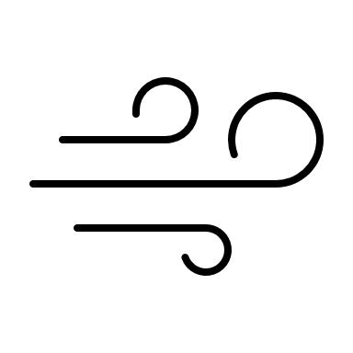
But other times my heart is cool. ​

Slide 16

I bob along gently like a balloon
on a string. ​​

Slide 17


My heart feels lazy and slow, as quiet as snowfall. ​​​

Slide 18

This is when my heart is calm.

