Slide 1
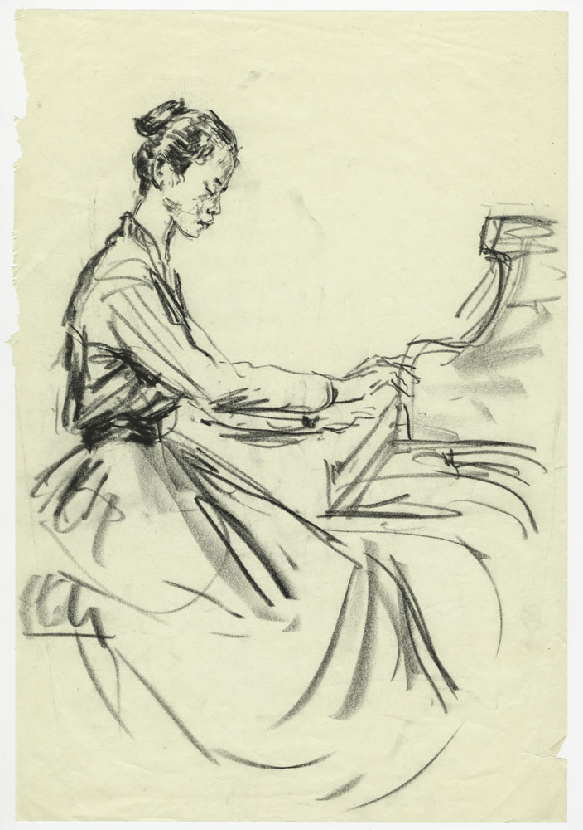


Royal College of Music Museum
Discover the Keyboard – KS1

Slide 2
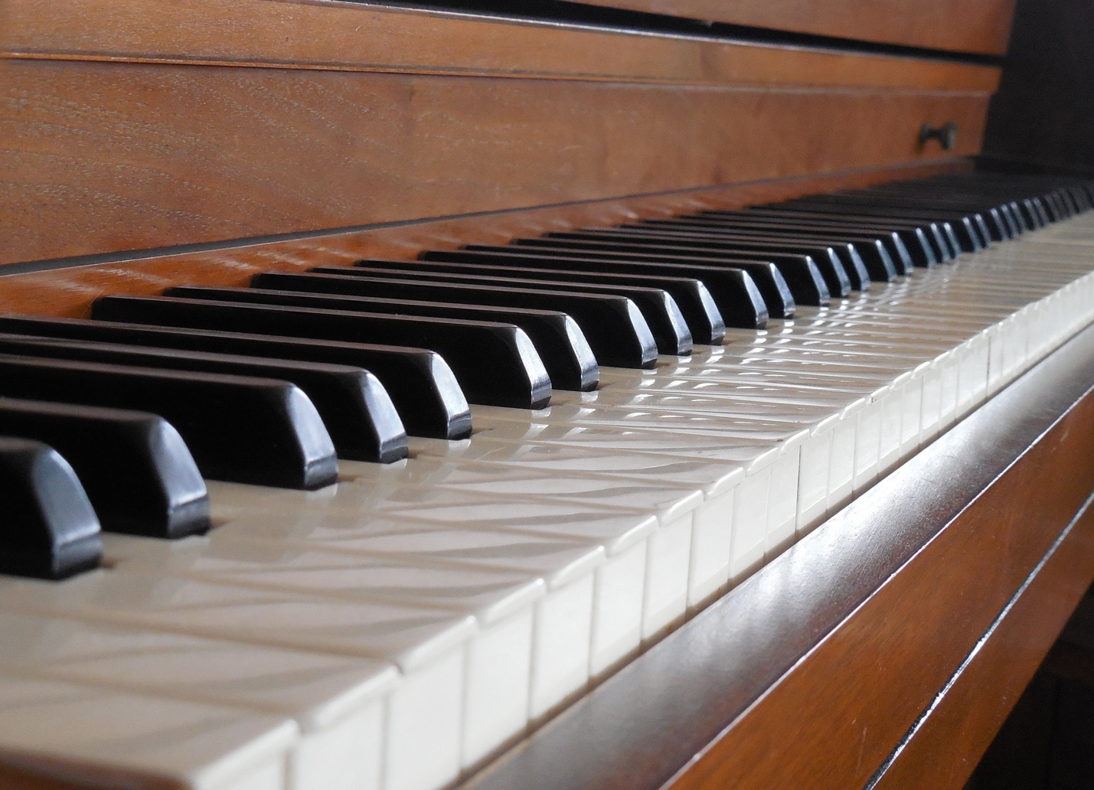
What is a keyboard instrument?
A keyboard looks like this.
It is made up of lots of individual black and white keys which produce a sound when you press them.

Slide 3
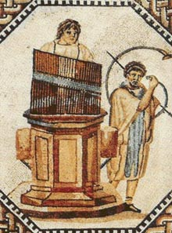
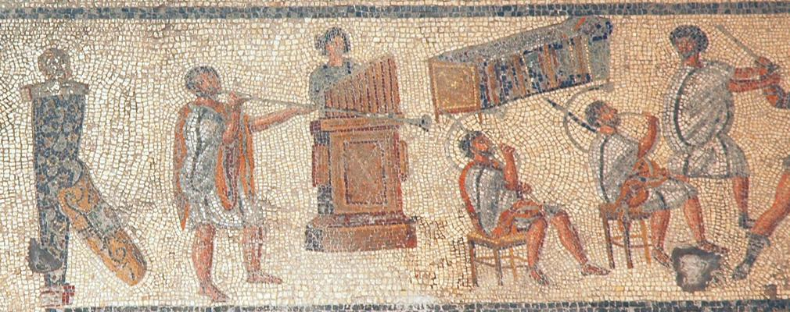
Historical keyboard instruments
FUN FACT!
The first keyboard instrument in the world was called a hydraulis.
It was invented by the Greeks more than 2000 years ago and used water to push air through the pipes when a key was pressed!

Slide 4
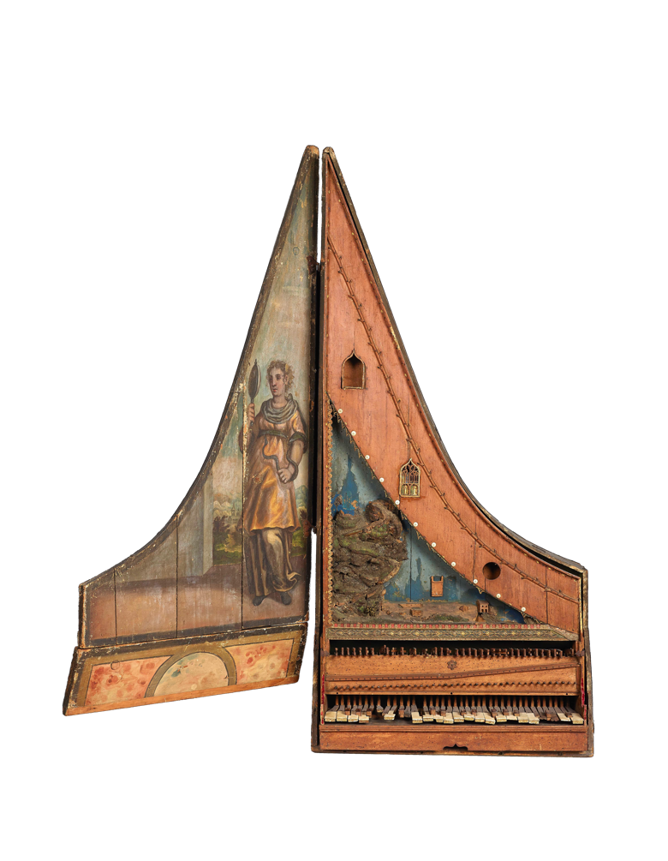
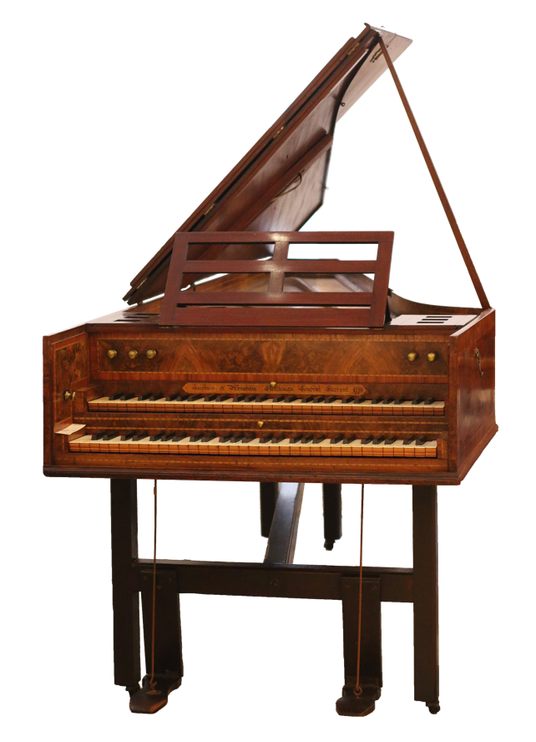
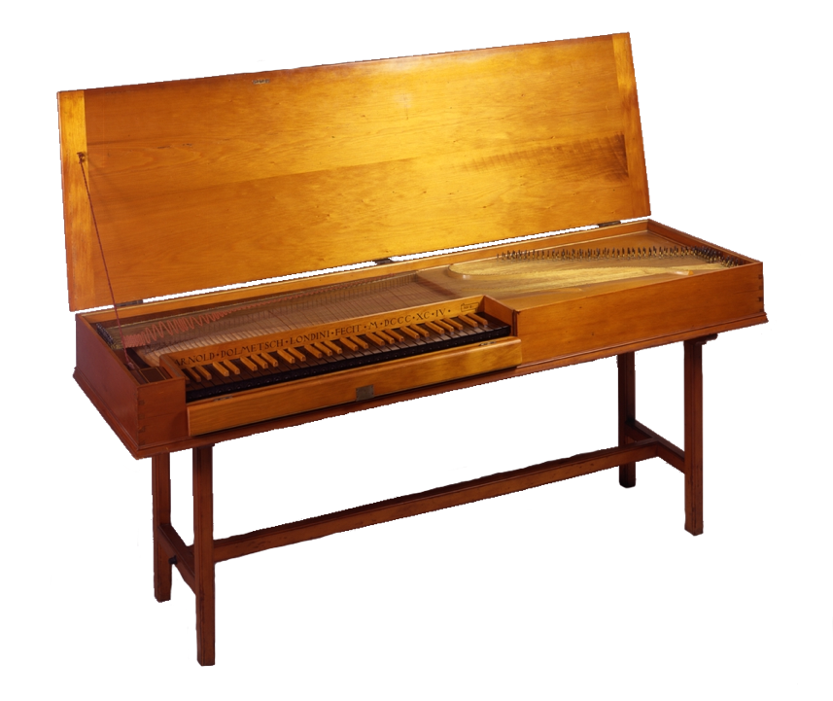
Here are some keyboard instruments you might never have heard of! They all have strings inside which make a sound.
Clavicytherium
Harpsichord
Clavichord
They are kept in the Royal College of Museum Museum.
The clavicytherium in our Museum is the oldest keyboard instrument in the world to use strings!

Slide 5
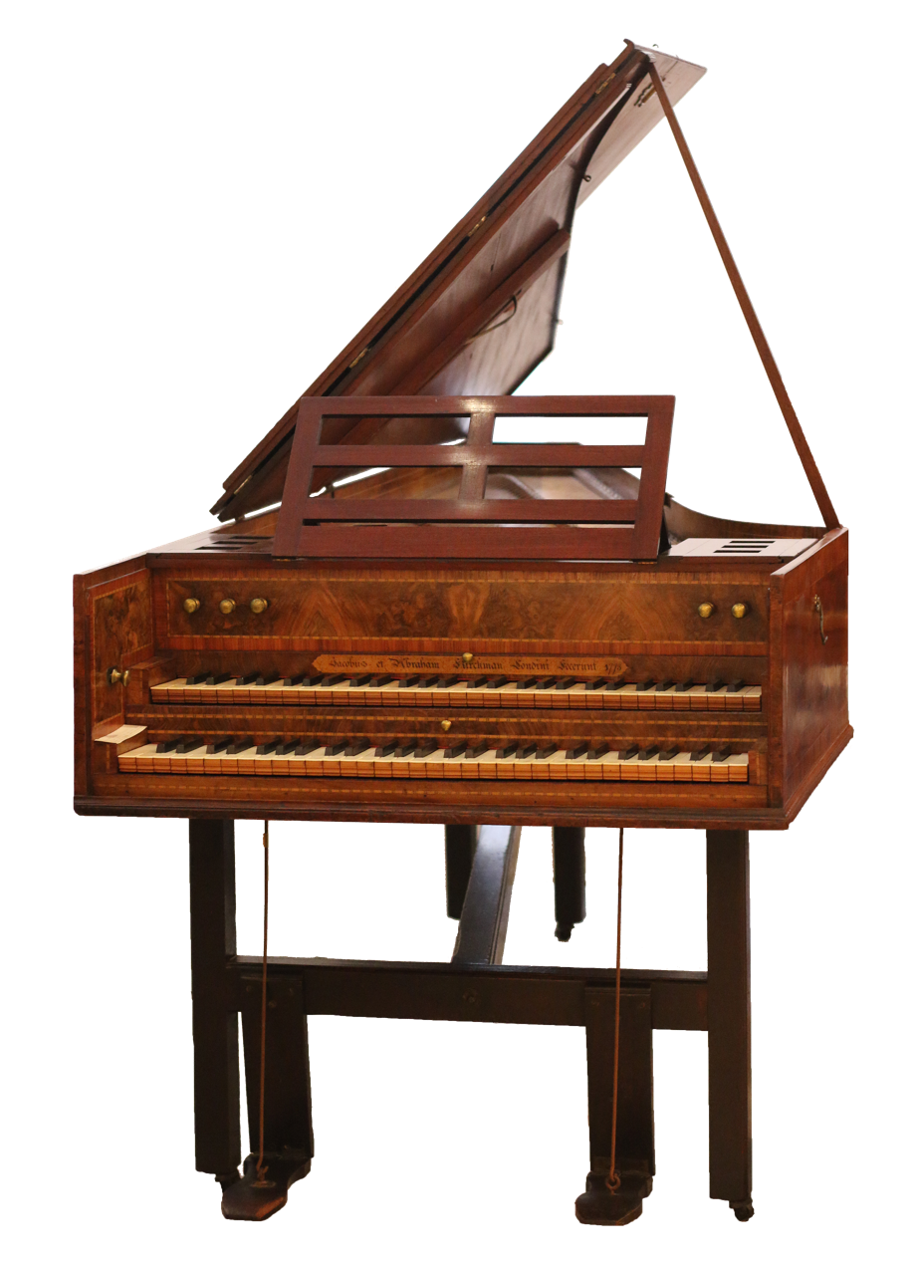
The harpsichord
The harpsichord looks a bit like a piano, but it sounds very different.
That is because the strings inside are plucked. The sound is tinkly and light.
It is difficult to make loud and soft sounds on the harpsichord. However gently or firmly you press the keys, the sound comes out the same.

Slide 6
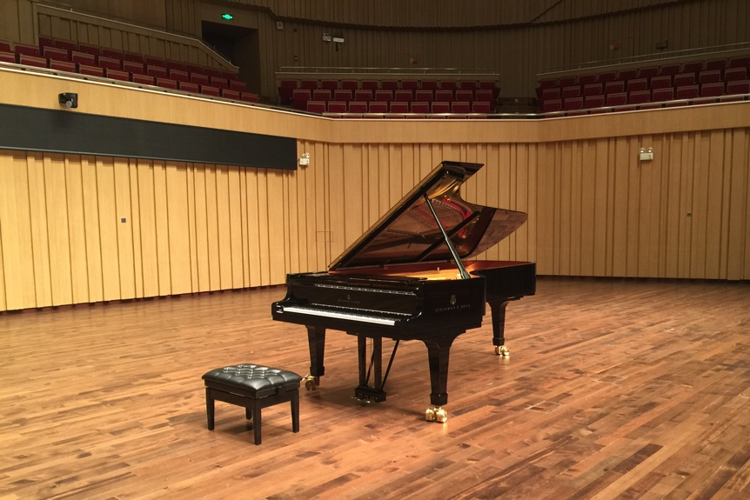
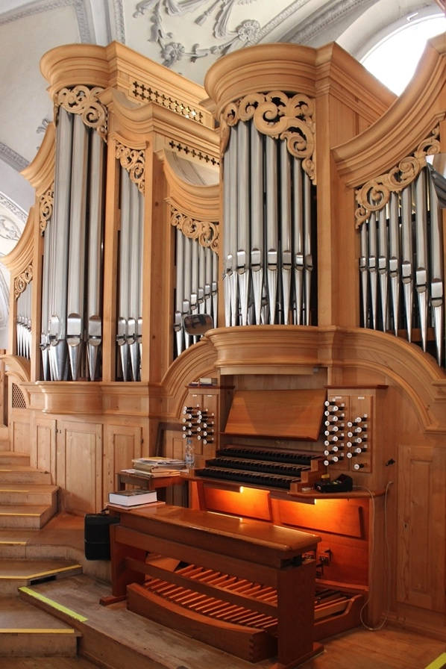
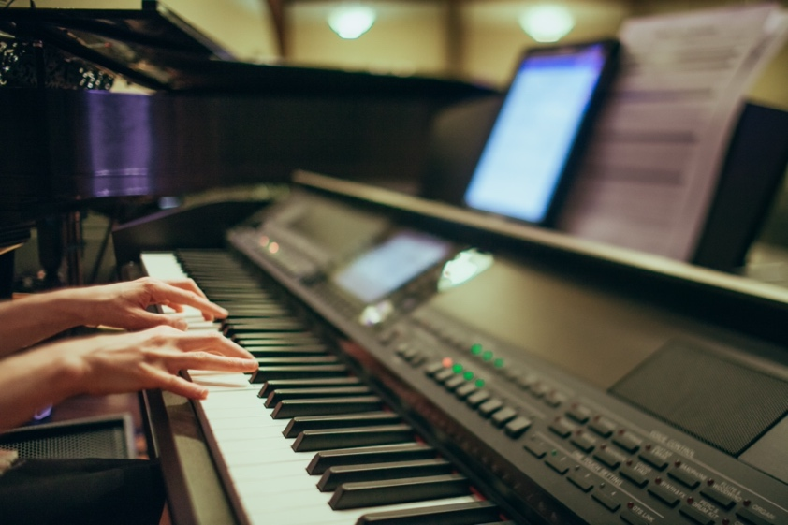
Keyboard instruments today
There are three main types of keyboard instruments which we see today:
Electronic keyboards
Piano
Organ
Notes:
Electronic keyboards include digital pianos, electronic organs, and synthesizers.

Slide 7
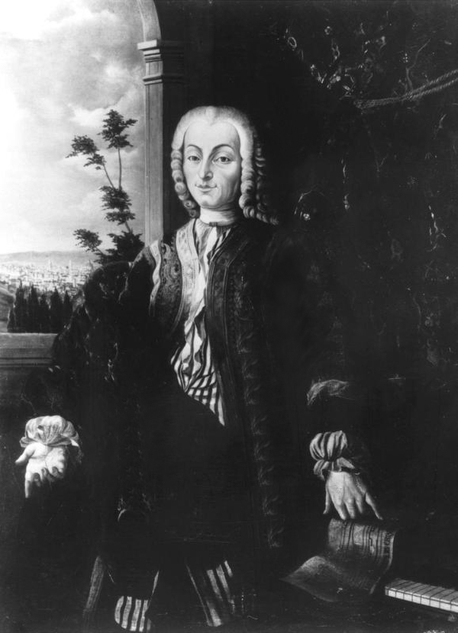
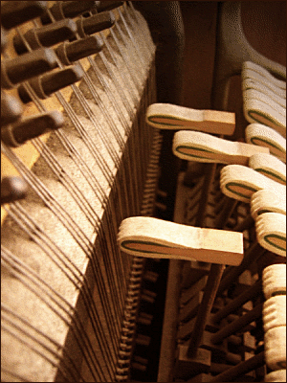
The piano
The most popular modern keyboard instrument is the piano.
Pianos were invented over 300 years ago by an Italian man called Bartolomeo Cristofori.
The piano is very different from a harpsichord. The strings inside a piano are hit with small hammers.
The piano can make loud and soft sounds.
Let’s find out a little bit more about the piano keyboard

Slide 8
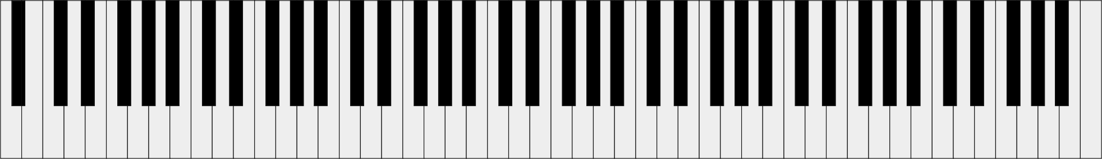

The piano keyboard
The piano has 88 keys! That is several octaves (the distance between two notes that sound the same.
There are 2 types of piano keys: black and white.
This is the lowest note on the piano.
It sounds like this:
This is the highest note on the piano.
It sounds like this:
Notes:
Should the sound files not work, they can be found here: http://theremin.music.uiowa.edu/MISpiano.html

Slide 9

Challenge Time!
Put your new keyboard knowledge to the test in your Activity Book.

