Slide 1
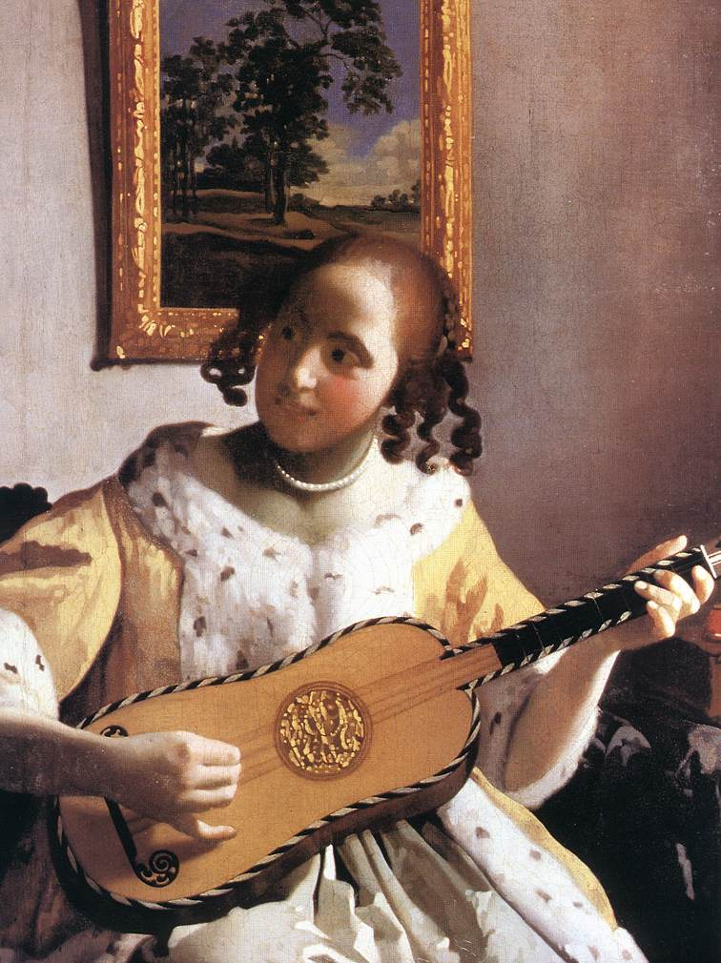


Royal College of Music Museum
Discover the Guitar – KS1

Slide 2
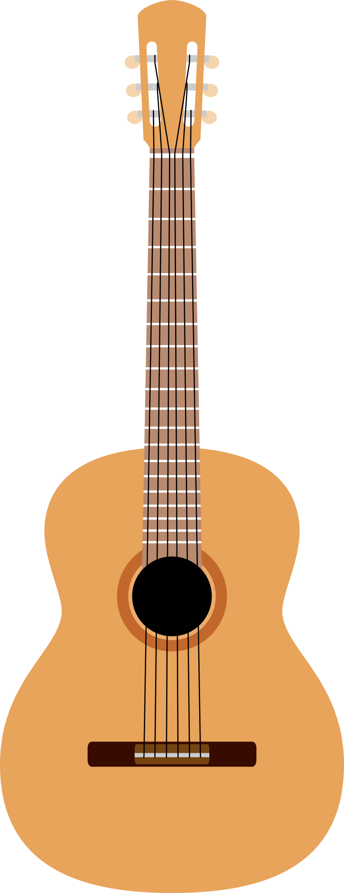
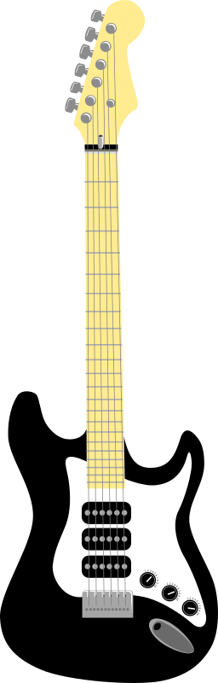
What is a guitar?
A guitar is a musical instrument that has 6 strings, a curvy body and a long neck.
They are one of the most popular instruments in the world,
Let’s find out more!

Slide 3
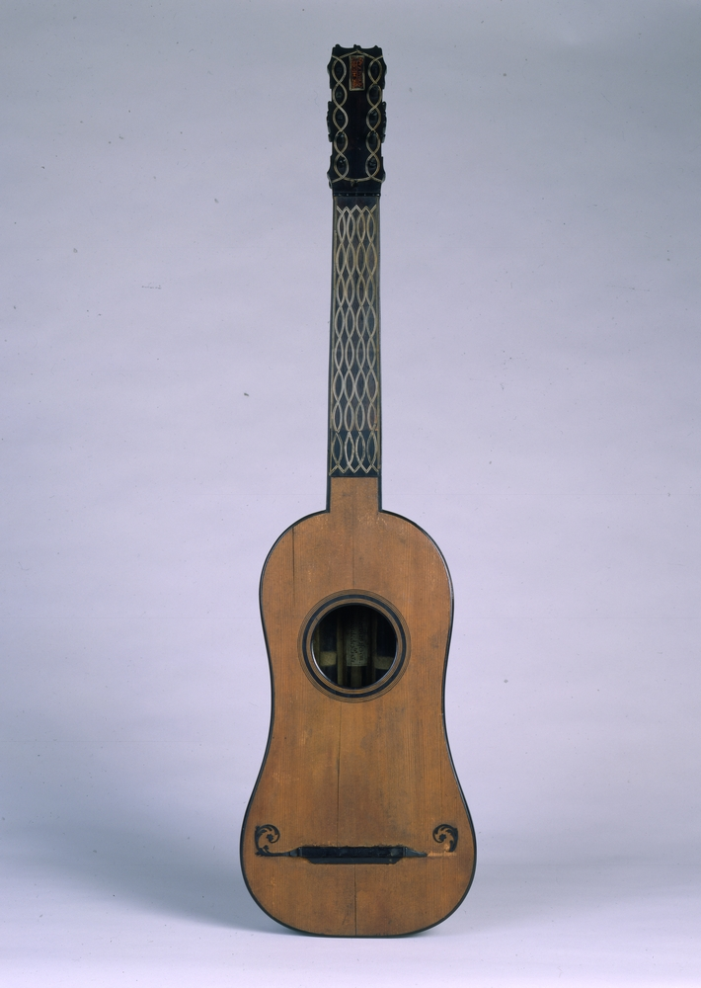
It’s how old?!
This guitar is the oldest one in the world.
It is on display in the Royal College of Music Museum.
It was made in Lisbon, Portugal in 1581. That’s over 400 years ago!
The man who made it was called Belchior Dias. We know this because he carved his name onto the top of the guitar.

Slide 4

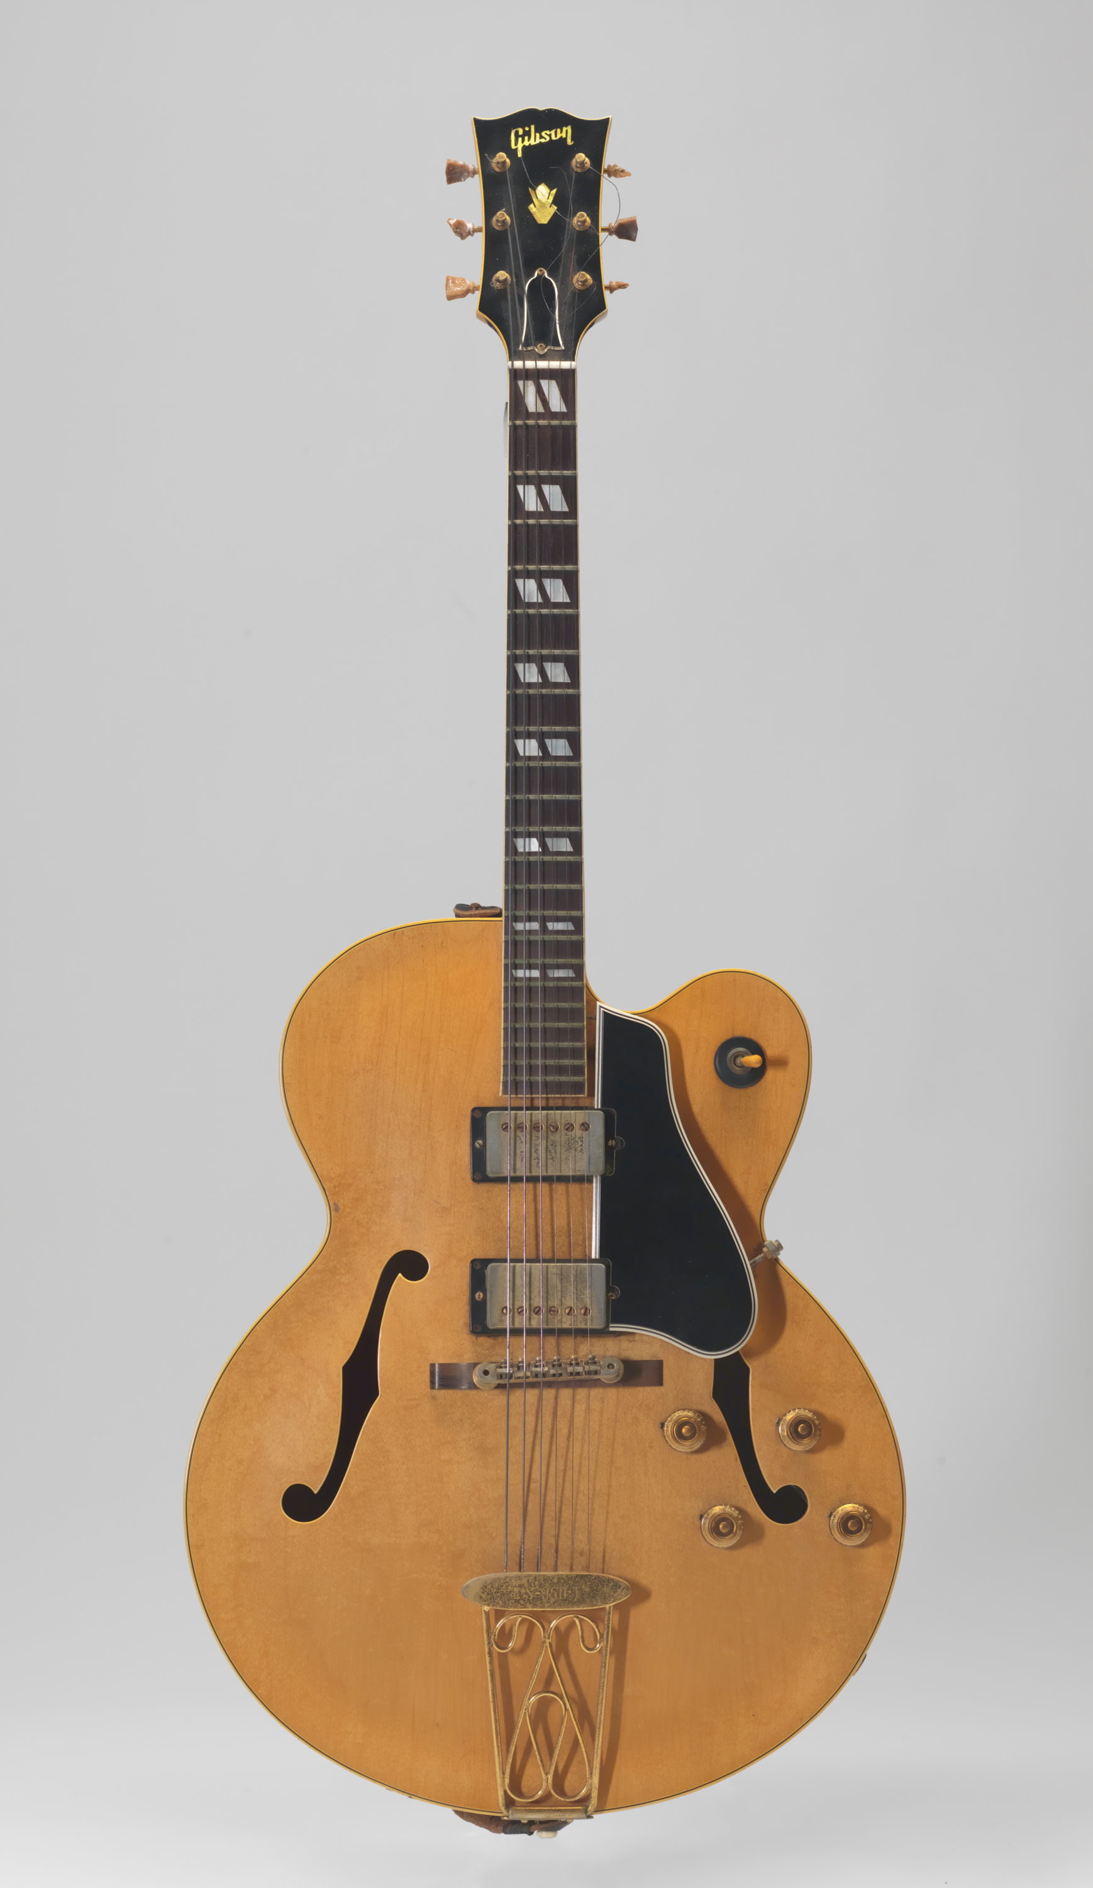
Types of guitar
There are 2 main types of guitar:
Acoustic
Electric

Slide 5
Acoustic guitar
Acoustic guitars make sound naturally.
You don’t need electricity.
Instead, the hollow body acts as a sound box. When you pluck the strings, the sound vibrates inside the body which helps to make the sound louder.
These guitars are usually made of wood and other natural materials, and have 6 strings.

Slide 6
Electric guitar
Electric guitars need electricity.
Electric guitars do not have a hollow body that helps make the sound louder. Instead,
electric power is used for amplification (making the sound louder so it can be heard from a distance). Electric guitars usually come with an extra box (amplifier) where the sound comes out.
If you go to a rock concert, this is the type of guitar you will most likely see.

Slide 7
Parts of a guitar
Guitars have many parts. Here are some important ones:
Body
Tuning pegs
Bridge
Fret
Neck
Headstock
Sound hole

Slide 8
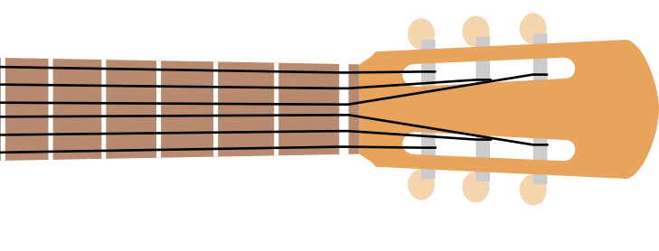
Guitar notes
Guitars have 6 strings. The top string is the thickest, lowest string.
The bottom string is the thinnest, highest string.
If tuned normally, the strings of a guitar play the following notes:
E
A
D
G
B
E
If you ever forget, just think:
Elephants And Donkeys Grow Big Ears!

Slide 9

Challenge Time!
Put your new guitar knowledge to the test in your Activity Book.

